Slide 1

Capstone Project: Analyze social media Engagement to uncover Business performance insights (Social-Tech)
Name: Kapil dev
Enrollment Number: EN12026089810
NIIT Batch Code: DA554S55
Mentor: Valli Natarajan

Slide 2
Business Objective:
Problem Statement:
Logistics Social media platforms generate vast amounts of engagement data, but raw metrics alone do not reveal meaningful insights. The challenge is to apply statistical and machine learning techniques—including descriptive statistics, sampling, hypothesis testing, chi-square analysis, and regression modeling—to uncover patterns, relationships, and predictive factors .
The goal is to provide actionable insights for improving content strategy and maximizing audience interaction.
Objective 1: Platform Analysis
Objective 2: Engagement Insights
Objective 3: Followers Growth Analysis
Objective 4: Independent $ Dependent Engagement Metrics
Objective 5: Analyze Creator performance
Objective 6: Assess the Relationships

Slide 3
Technology Stack
Python – EDA, statistics, ML
SQL (MySQL) – Aggregation, joins
Power BI – Interactive dashboards, KPI extraction
Libraries – Pandas, NumPy, Sklearn, Matplotlib, Seaborn, Scipy

Slide 4
Data Description
Domain: Social Media Engagement
Datasets: audience_demographics, creator, engagement, post, sponsorship
Records: Large-scale data
Data used after cleaning & preprocessing

Slide 5
Data Cleaning & Handling missing values
Cleaning Actions Performed
Removed duplicate records
Handled missing values in Engagement and Post data
In the Engagement table found 8,876 null values, Removed Null Records using .dropna() function.
In the Post table found 8,433 null values ,Removed Removed Null Records using .dropna() function
Cleaning Insight: This records were holding a space in both the datasets in a huge amount, so applied .dropna() to remove Null records to free up the space in the datasets

Slide 6
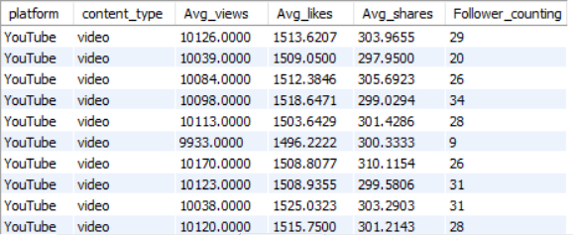
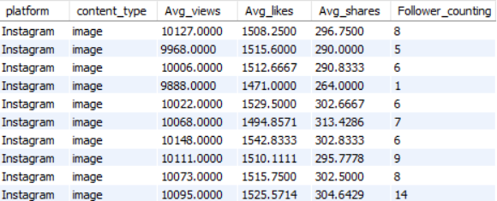
The output highlights that even creators with fewer followers can achieve similar engagement levels, which is important for understanding platform dynamics and audience reach.
This consistency suggests that Instagram image posts in this sample perform at a stable engagement level.
Follower counts vary more widely (from 1 to 14), showing differences in creator popularity even though engagement metrics remain similar.

Slide 7
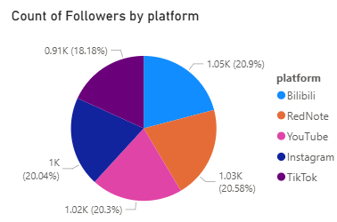
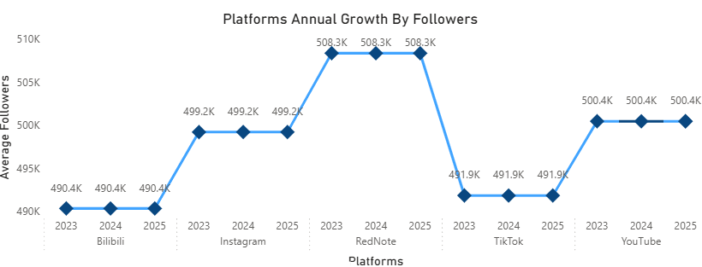
Platform Analysis
Follower Distribution:
Followers are spread evenly across platforms, with Bilibili (20.9%), RedNote (20.6%), YouTube (20.3%), and Instagram (20%) leading. TikTok trails slightly at 18.2%.
The line chart illustrates average follower counts across platforms from 2023 to 2025. RedNote emerges as the strongest performer, peaking at ~510K followers and maintaining that level. Instagram and YouTube show moderate growth, rising from ~490K to ~500K before stabilizing. In contrast, Bilibili and TikTok remain flat at ~490K, indicating stagnant growth. Overall, the chart highlights that while some platforms experience expansion, follower counts tend to plateau by 2025, reflecting market saturation and stabilized audience engagement.

Slide 8
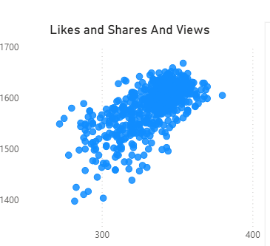
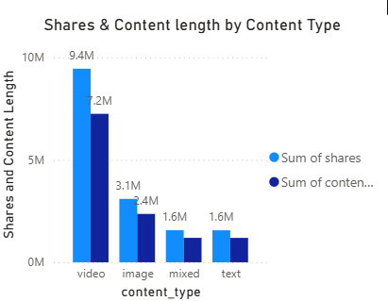
Engagement Insights
The scatter plot illustrates the relationship between maximum views and maximum likes, with data points clustered between ~10,000 views and ~1,500 likes. The positive correlation indicates that as views increase, likes also rise proportionally, highlighting a strong link between reach and engagement.
Video is the most engaging format: Audiences are more likely to share videos, and creators tend to produce longer video content.
Images perform reasonably well, but not at the same scale as videos.
Mixed and text formats struggle to generate shares, indicating lower audience preference or limited reach.

Slide 9
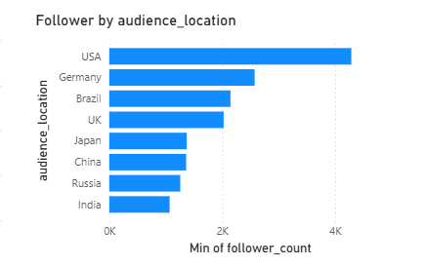
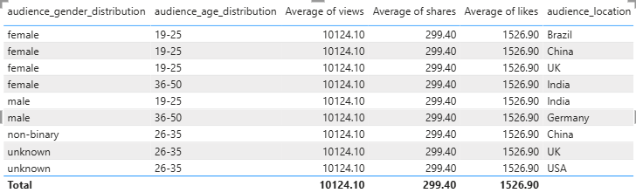
Audience Demographics
The clustered chart suggests that Western countries (USA, Germany, Brazil, UK) provide a stronger foundation for follower growth, making them key markets for content creators.
The chart emphasizes that audience location matters: creators in certain regions start with a higher baseline of followers, which can influence overall engagement and reach.
The data implies that audience engagement is consistent across demographic categories — gender, age, and location do not appear to influence average views, likes, or shares..

Slide 10
Hypotheses
Hypothesis : The Overall followers Growth.
Ho : There is no Increment in Follower’s Growth.
H1 : There is Increment In Followers’s Growth.
Conclusion :p‑value ≥ 0.05, we fail to reject the null hypothesis, This means the data does not provide enough evidence to conclude that the average follower count is higher.
Engagement Matrices
CHI-SQAURE TEST OF INDEPENDENCE
Null Hypothesis: Views, Likes, and Shares are independent (no relationship).
Alternative Hypothesis: Views, Likes, and Shares are dependent (there is a relationship)
conclusion:The Chi‑Square test result indicates that there is no statistically significant evidence to suggest that Views, Likes, and Shares are dependent on each other.

Slide 11
Machine Learning Models’ Insights
Model Used: Linear Regression
Conclusion:
The regression suggests that longer content is associated with slightly more likes.
This could imply that audiences tend to engage more (liking posts) when content is longer, possibly because longer posts provide more detail or value.
Metric | Value
Intercept | 1509.978
Slope | [0.00070762]
Model Used: Linear Regression
Conclusion:
The regression suggests that longer content is associated with fewer views, though the effect size is minimal.
This could imply that audiences prefer shorter content for higher engagement, or that longer posts/videos may not attract as many views.
Metric | Value
Intercept | 10100.94
Slope | [-0.00137789]

Slide 12
Meachine learning Model’s Insights
Applied k-means clustering on standardized engagement metrics (views, likes, shares, comments_count) to identify distinct patterns of user interaction. The algorithm grouped the data into three clusters, representing low, medium, and high engagement levels. This clustering provides actionable insights into audience behavior, enabling us to distinguish typical posts from highly engaging ones and tailor strategies accordingly."
Cluster 0: Likely represents low engagement records. These may have fewer views, likes, shares, and comments.
Cluster 1: Could correspond to moderate engagement. Balanced activity across metrics, possibly typical or average posts.
Cluster 2: Represents high engagement records. These posts likely went viral or attracted significant attention across all metrics
Applied Logistic Regression to predict disclosure type based on sponsor category. While the model achieved an accuracy of 52.66%, the classification report revealed that it only performs well for class 0 and fails to identify class 1. This suggests that sponsor category alone is not a strong predictor of disclosure type. Future work should incorporate additional features and address class imbalance to improve predictive performance."
Metric | Value
Accuracy | 52.66%
Precision | 0.53

Slide 13
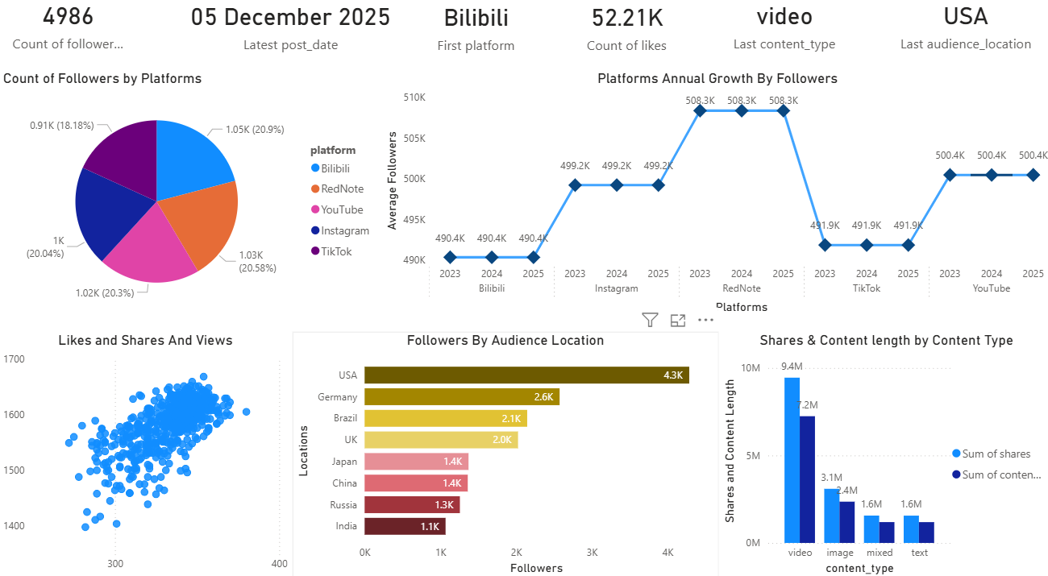
Social Media Performance Analysis
Narrative:
Our social media ecosystem demonstrates balanced growth across platforms, with video content emerging as the most powerful engagement driver. The global audience distribution highlights opportunities for targeted campaigns in North America and Europe, while maintaining a strong presence in emerging markets. By focusing on video-first strategies and leveraging platform diversity, we can continue scaling engagement and reach."

Slide 14
Summary
This project demonstrates that video-first strategies and cross-platform growth are key drivers of engagement.
Targeting younger demographics (19–25) and focusing on regional hubs like North America and Europe offers strong potential for brands.
Sponsorships are most effective when aligned with creators producing high-engagement video content.
Overall, the findings provide actionable insights for optimizing content strategy, strengthening audience interaction, and maximizing sponsorship outcomes.
Regression Models demonstrated that content length positively influences both views and likes, reinforcing the importance of thoughtful content design.

Slide 15
THANK YOU

